Slide 1
Phi Theta Kappa
Orientation and INFORMATION MEETING

Slide 2
Overview
Brief History
Eligibility of membership
Why one becomes a member
Hallmarks
Officers
Events and Volunteering opportunities
Star-Levels

Slide 3
Phi Theta Kappa’s History
1918: Society founded at Stephens College, Columbia, Missouri
1919: First Convention held
1929: Official recognition granted by the American Association of Comm. Colleges
1930: The Golden Key membership pin is adopted
1964: Phi Theta Kappa establishes first National Office (Headquarters building)
1966: First Regional Convention held
1968: First Honors Institute held commemorate 50th anniversary
1969: Regional organizations established, Regional Coordinators selected
1975: First transfer scholarship designated specifically for a Phi Theta Kappa
1976: First alumni chapter chartered.
1988: Phi Theta Kappa reaches all 50 states
1991: First international chapter, Phi Theta Kappa charters 1,000th chapter
Today, Phi Theta Kappa is the largest honor society in American higher education with more than 2 million members and 1,200 chapters

Slide 4
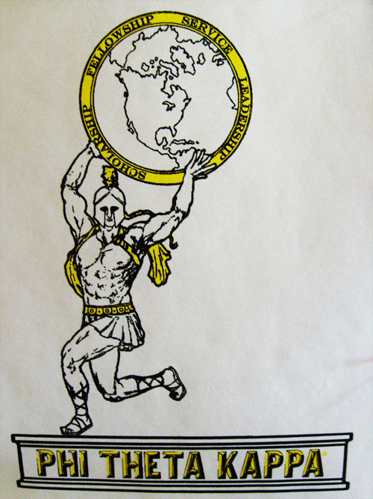
Alpha Delta Alpha (A∆A )
Eligibility for A∆A Membership
Enrolled at the Coon Rapids Campus
Overall grade point average (GPA) of 3.5 or above.
At least 12 credits earned at 1000 level or above
Maintaining Membership
3.0 overall GPA (one warning semester)
No serious disciplinary actions
Revocation of Membership
In the event that a member does not meet the requirements for continuing membership their case will be reviewed (see By-Laws)

Slide 5
Why become a member?
Scholarship and Transfer Resources
CollegeFish.org
Letter of Recommendation for college admissions counselors
Career Resources
Career Resource Center
Letter of Recommendation for potential employers
Recognition of Your Academic Achievement
Golden Key Membership Pin
Embossed Membership Certificate and Identification Card
Development of Character and Skill
Engage in Service Learning
Apply and Expand Leadership Skills
Experience
Personal Pride

Slide 6
Hallmarks
Scholarship Hallmark
Leadership Hallmark
Service Hallmark
Fellowship Hallmark
Phi Theta Kappa focuses on four areas in order to improve ourselves, our society, and direct the student ideals. These four areas, called Hallmarks, are Scholarship, Leadership, Service, and Fellowship.

Slide 7
Scholarship Hallmark
Primary Focus
Honors Study Topic
2010-2011 Honors Study Topic: The Democratization of Information: Power, Peril and Promise.
Secondary Focus
Recognize and encourage scholarship; mentoring and tutoring

Slide 8
Leadership Hallmark
Primary Focus
Leadership Roles/Positions on campus, in the community and in the region or beyond
Secondary Focus
Leadership Development for members and others

Slide 9
Service Hallmark
Primary Focus
Honors in Action Initiative: Combines scholarly inquiry and research with leadership to increase awareness and service to the community. The individual or chapter can make a difference regarding the issue explored or discovered by studying the topic.
Secondary Focus
Other service activities unrelated to the Honors in Action Initiative, as chosen by the chapter.

Slide 10
Fellowship Hallmark
Incorporated into the other Hallmarks and includes activities within the chapter, on campus, in the community, and in the region or beyond.

Slide 11
Officers and Events
Different Officer Positions within the Phi Theta Kappa Board…
V.P. of Leadership
V.P. of Scholarship
V.P. of Service
V.P. of Fellowship
V.P. Of Technology
Historian
EHA
EHA
EHA
EHA
EHA
President
Advisor
V.P of Public Relations

Slide 12
President
Responsibilities:
Prepare meeting agendas and lead meetings
Appoint necessary committees
May only vote in the case of a tie
Develop goals for the chapter with other officers and advisors
Submit Five Star Goal and Update Forms online
Oversee chapter projects
Oversee award entry preparation
Report successive officers to Headquarters

Slide 13
Vice-President of Leadership
Responsibilities:
Coordinate Leadership activities
Provide leadership and leadership development opportunities for students and community members
Implement the Five Star Program and oversee preparation of Leadership area Hallmark Award entries.

Slide 14
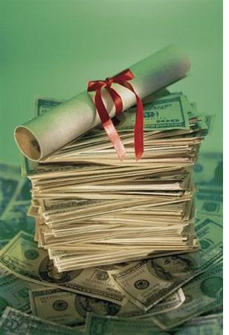
Vice-President of Scholarship
Responsibilities:
Coordinates lectures, discussions, and films related to the Honors Study Topic
Promotes the Satellite Seminar Series
Oversee preparation of Scholarship area Hallmark Award entries
Provide students with information on Phi Theta Kappa scholarships
Provides activities on campus and in the community to concentrate on Honors in Action

Slide 15
Vice-President of Service
Responsibilities:
Oversee International Service Program activities
Supervise community activities
Oversee preparation of Service area Hallmark Award entries
Plan and execute community outreach activities and plan yearly service activities
Maintain relationships with organizations that chapter has worked with in the past and branch out to create new relationships

Slide 16
Vice-President of Fellowship
Responsibilities:
Organize fellowship events
Work with campus and community organizations for cooperative opportunities
Maintain ties with sister chapters
Encourage scholarly fellowship at all levels of the Society
Implement strategies to increase membership acceptance
Remind chapter to have fun too!!!

Slide 17
Vice-President of Technology
Responsibilities:
Maintain chapter web page with advisor
Help create and maintain electronic chapter files in the College I drive
Maintain technological edge by researching other chapter websites and keeping up with International links and sites
Make sure technological equipment is being used and maintained properly in the Phi Theta Kappa office and in College spaces used by the chapter

Slide 18
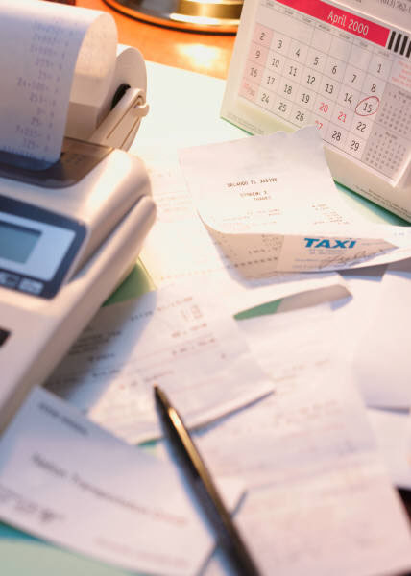
Historian
Responsibilities:
Take and present minutes at chapter meetings
Record chapter activities
Maintain chapter bank account
Manage budget with advisor
Organize chapter files/pictures

Slide 19
Vice-President of Public Relations
Responsibilities:
Submit articles and photographs to local papers regarding events such as the Induction Ceremony
Photograph chapter activities
File photos and newspaper clippings
Advertise for Phi Theta Kappa events
Spread the word about our chapter on campus and off campus
Aid event chairs with publicity design

Slide 20
Executive Hallmark Assistants (EHA)
“Being an EHA was a great way to learn what the officers did, learn more about Phi Theta Kappa, and help out in a meaningful way.”
Existing Positions
EHA of Scholarship
EHA of Leadership
EHA of Service
EHA of Fellowship
EHA of Technology
Responsibilities
Maintain close relationship with your “buddy” officer
Assist assigned Vice-President in their chaired events
Plan activities and stay updated and in contact
Attend board meetings in place of assigned Vice-President if they are unable to attend

Slide 21
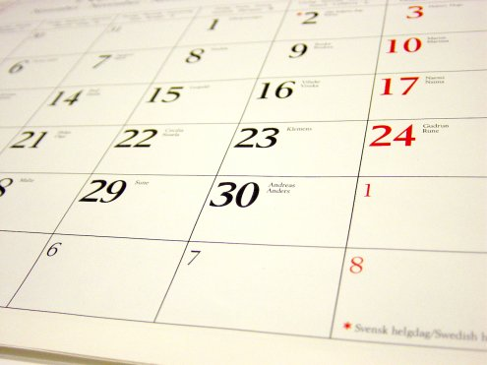
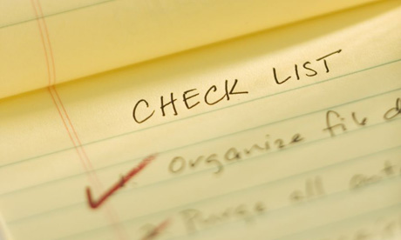
Calendar of Events
Spring
Semester Events
February:
25-26th: Regional Conference, Normandale Community College
March
2nd: Member meeting, 2-3 p.m., B255
4th: Feed My Starving Children, 2:15-4:30 p.m.
April
1st: Feed My Starving Children, 2:15-4:30 p.m.
6th: Member meeting, 2-3 p.m., B255
6-10th: International Convention, Seattle, WA
13th: Adopt-a-Highway Cleanup, 8 a.m.-3 p.m.
20th: Campus Clean-up, 8 a.m.-2 p.m.
26th: Induction Ceremony, 5:30 p.m., PAC (Earlier for inductees.)
27th: Golden Chalk Award Presentation
28th: Red Cross Blood Drive, 8 a.m.-2 p.m., TBA

Slide 22
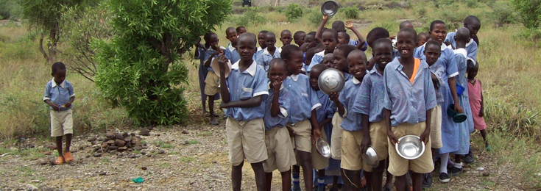
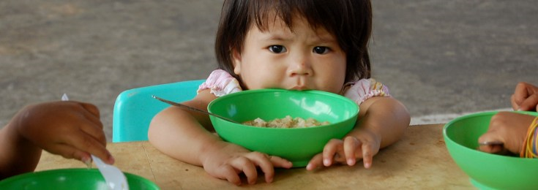
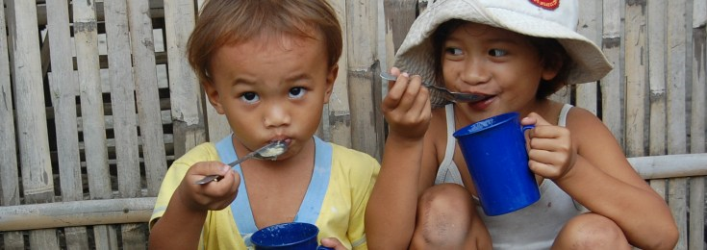
Feed My Starving Children
This event is held every month
First Friday of the month, 2:30pm -4:30pm and sometimes 6:30pm - 8:30pm

Slide 23
Adopt-a-Highway Clean-Up and Campus Clean-Up
These events are held every Spring and Fall Semesters!
Volunteer this and next semester!
Adopt-A-Highway Clean-Up
Campus Clean-Up
Wednesday April 20
Wednesday April 13
Helps beautify our campus by cleaning up the trash!
Helps the environment!
Helps clean up the trash that litters the roads!
Helps the environment!

Slide 24
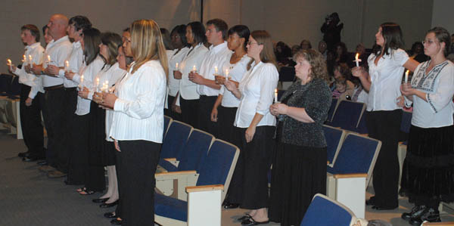
Induction
April 26, 2011
Induction is Tuesday April 26,2011.
The ceremony begins at 5:30 PM in the Performing Arts Center.
The ceremony lasts about an hour.
We ask that you be there at 4:30 PM.
This is a special occasion. Please dress appropriately.
You do not need to wear a suit, sport coat and tie or dress, but please dress nicely.
At 4:30 PM photographers will be there to take photos for local news releases.
We will also have a rehearsal for the ceremony.
Please invite family and friends to attend.
We also encourage you to invite any faculty members who have made significant contributions to your academic success. You will be provided an opportunity to acknowledge or thank them during the program.
There will also be a reception after the ceremony for Inductees and guests. Cake and punch will be provided.

Slide 25
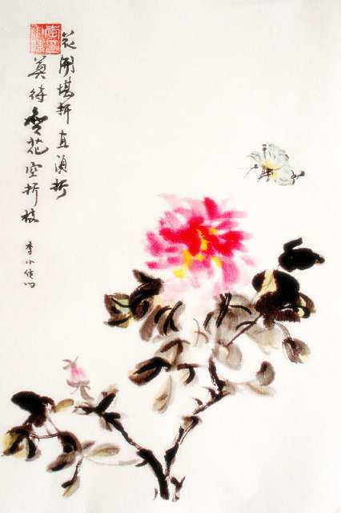
Additional Spring Events
Golden Chalk Awards
Chinese Garden Clean-Up
Vote For Your Most Outstanding Professor!
Come help clean up and restore a memorable garden!
The top vote will receive the Golden Chalk Award plaque. The runner-up will receive the Silver Chalk Award plaque.
The project honors and embraces our sister college in Zhaoqing, China

Slide 26
Blood Drive
This events is held every Spring and Fall Semesters!
Volunteer and/or Donate this and next semester!
It feels great to donate!
You get free juice and cookies.
It's something you can spare – most people have blood to spare... yet, there is still not enough to go around.
You will help ensure blood is on the shelf when needed – most people don't think they'll ever need blood, but many do.
You will be someone's hero – in fact, you may help as many as three people with just one donation.

Slide 27
Star-Levels
Our Chapter’s Star Level program encourages members to increase participation through a series of incentives and recognition points. With increasing levels of commitment, measured through participation, members are awarded a certificate of achievement for that level, and given a gift as well:
Star Level Four
Star Level Three
Star Level Two
Star Level One
Star Level Five
Star Level One: Phi Theta Kappa bumper sticker
Star Level Two: Phi Theta Kappa gold graduation tassel
Star Level Three: Phi Theta Kappa stole for graduation
Star Level Four: Phi Theta Kappa t-shirt
Star Level Five: Phi Theta Kappa sweatshirt

Slide 28
Trivia and Vice-President of Public Relations Election
Please answers the trivia questions in your folder (left pocket)
Candidates for position the Vice-President of Public Relations will present a brief blurb about themselves and their qualifications.
After consideration, we shall vote in the new Vice-President!

Slide 29
Thanks For Coming!
Next member meeting Wednesday March 2
Same Time
Same Place
See you there!!

